Slide 1
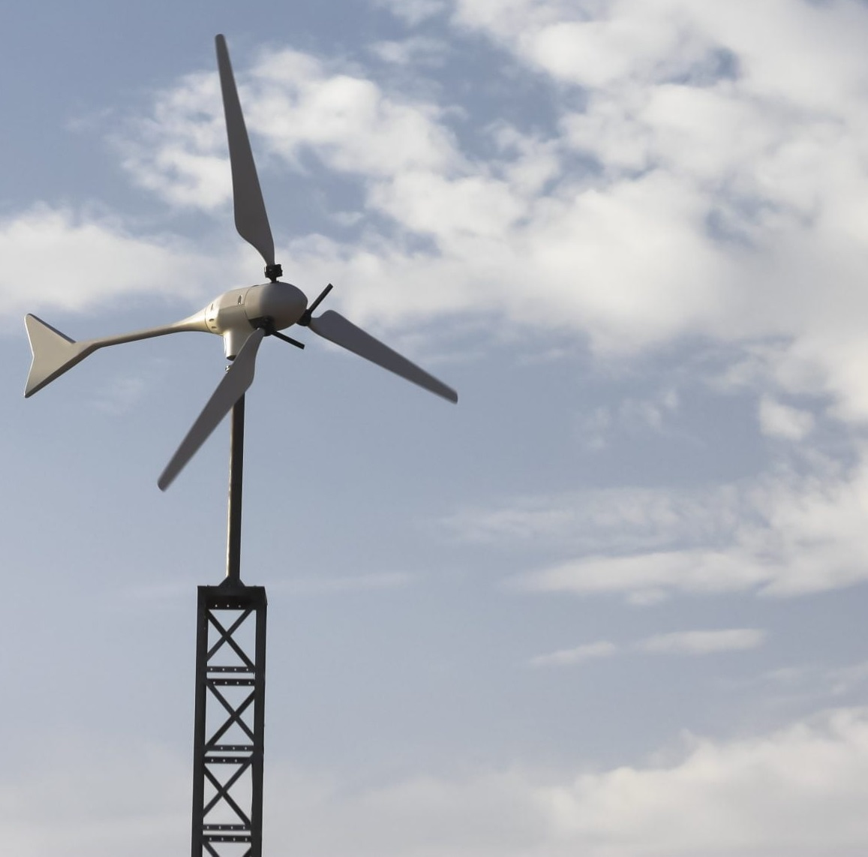

Team 7:
Wind-Powered Building
Team Members:
Colton, Reginald, Maxwell, Peter
Sponsor: Dr. Jang TA: Rohith Ramanujam Kumar
2nd Status Update
Notes:
https://www.ryse.energy/3kw-wind-turbines/#iLightbox[gallery_image_1]/11

Slide 2
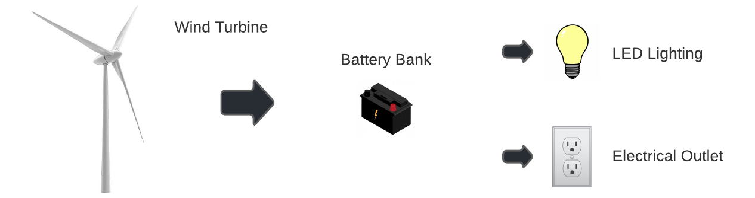
Project Summary
Implementing local renewable power generation to reduce reliance on fossil fuels
Using a wind turbine to capture energy, store it in batteries, and power AC and DC loads

Slide 3
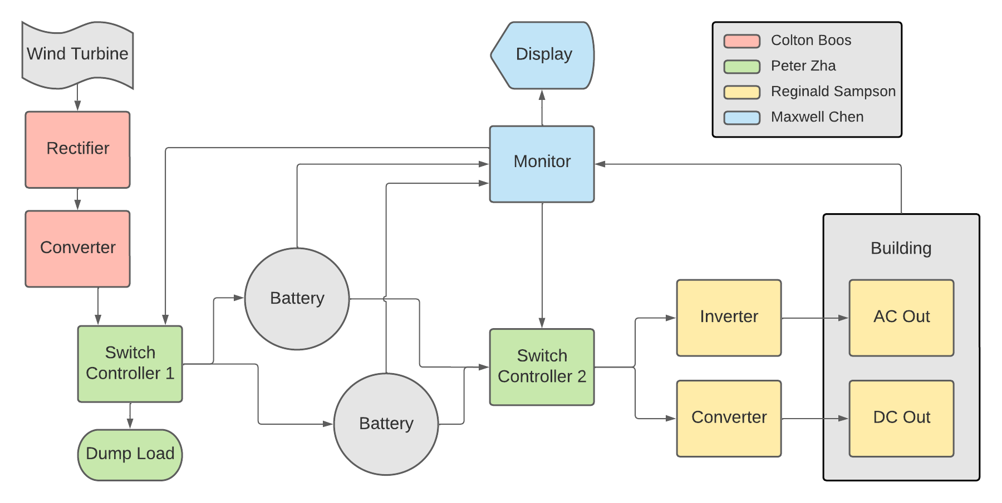
Block Diagram and Task Partition

Slide 4
Project Timeline
Early September
Late September
Early October
Late October
Late October
Late November
Refine Subsystems
Begin Integration
Continue Integration
Continue Integration and Validation
Continue Integration and Validation
Complete Validation
Ensure subsystems are in a working state and simulations are done.
Resolve any subsystem issues left over from the previous semester.
All subsystems should be in complete working order with PCBs on the way.
Begin integrating rectifier with boost converter.
All other PCBs should be ordered and ready to integrate.
Integrate Switch controllers with monitor subsystem.
Integration of Rectification and Conversion Subsystem with Switch Controller 1
Integration of Inversion and Conversion Subsystem with Switch Controller 2
Complete and document final validation tests for final report and presentation.
Done
In Progress
Behind Schedule
Not Started

Slide 5
Rectification and Conversion Subsystem
Owner: Colton Boos
Accomplishments since last review 15 hours of effort | Ongoing progress/problems and plans until the next presentation
Finished PCB design for buck-boost converter and placed order | Finish soldering components onto rectifier and converter PCBs Validate they’re both working independently Begin integration of both circuits

Slide 6
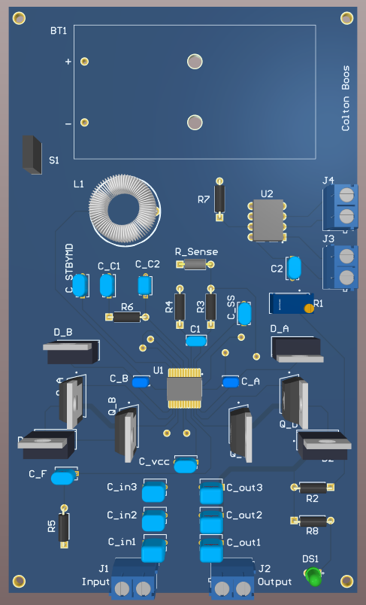
Rectification and Conversion Subsystem
Owner: Colton Boos
Buck-Boost Converter
Output voltage depends on feedback resistor
For charging batteries, there are different charging methods available
Currently planning to implement constant voltage charging with analog resistor
Added functionality for digital potentiometer for constant current charging

Slide 7
Switch Controller Subsystem
Owner: Peter Zha
Accomplishments since last review 10 hours of effort | Ongoing progress/problems and plans until the next presentation
Fixed newfound errors in simulation and design Nearly complete PCB designs | Finish up and order PCBs Physical validations on breadboard while waiting for PCBs Begin integrating

Slide 8
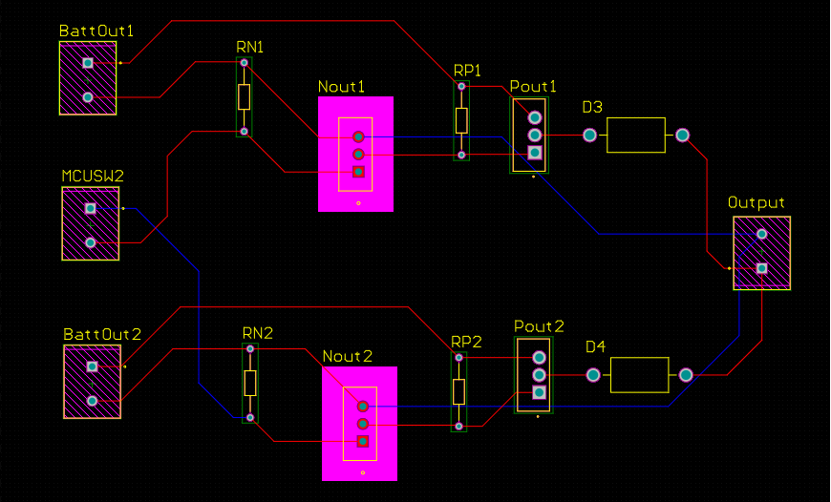
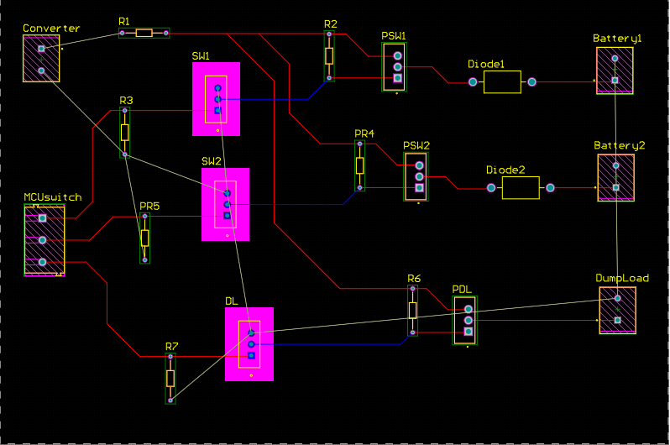
Switch Controller Subsystem
Owner: Peter Zha

Slide 9
Inversion and Conversion Subsystem
Owner: Reginald Sampson
Accomplishments since last review 10 hours of effort | Ongoing progress/problems and plans until the next presentation
Validated the rebuilt converter and inverter breadboard circuits Designed converter and inverter PCBs Began reconstruction of physical network connecting to the loads | Get feedback from Dr. Lusher on PCB designs Order PCBs

Slide 10
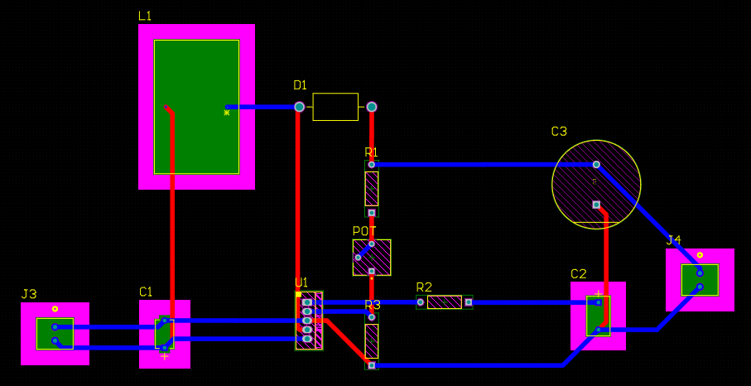
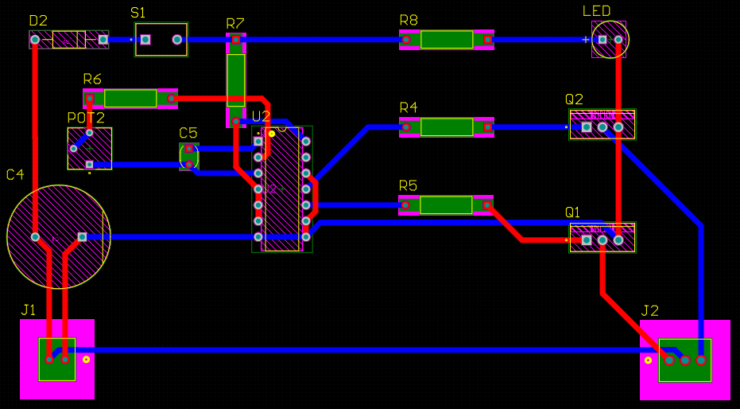
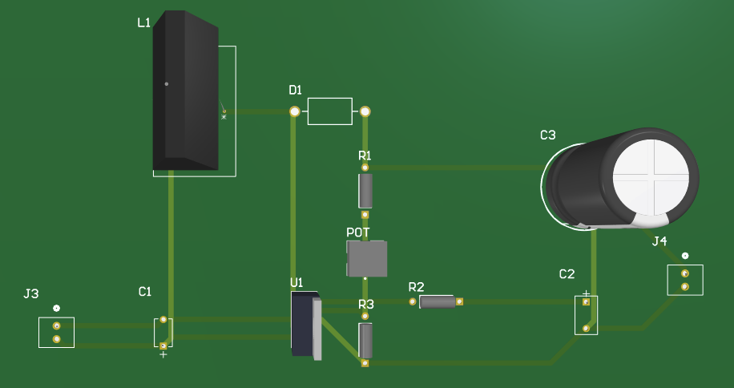
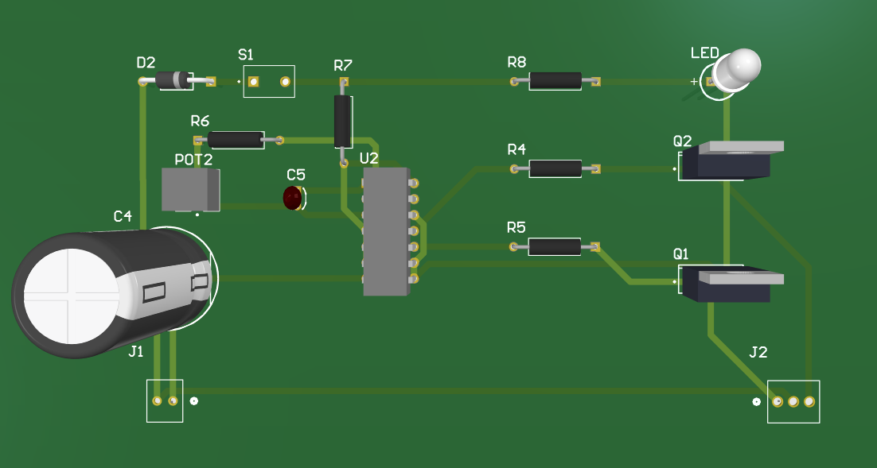
Inversion and Conversion Subsystem
Owner: Reginald Sampson
Converter
Inverter

Slide 11
Monitor Subsystem
Owner: Maxwell Chen
Accomplishments since last review 8 hours of effort | Ongoing progress/problems and plans until the next presentation
Working on code for the current sensors and implementation of Battery Health Research and discussion with team members on optimal battery charging | The new sensors were delayed and did not arrive last week Continue working on code and implementing the sensors this week along with testing if possible

Slide 12
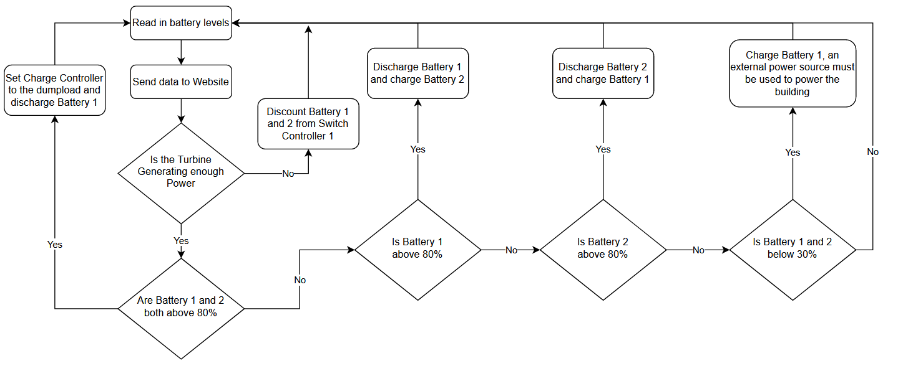
Monitor Subsystem
Owner: Maxwell Chen
Flow Chart for battery switching logic

Slide 13
Parts Ordering Status
Part Description | Status(Order Approved/ Order Placed/ Part Received
HiLetGo Voltage Sensor | Parts Received
INA219 Current Sensor | Parts Received
Power MOSFETs | Parts Received
Rectifier PCB | Order Received
Converter PCB | Order Placed

Slide 14
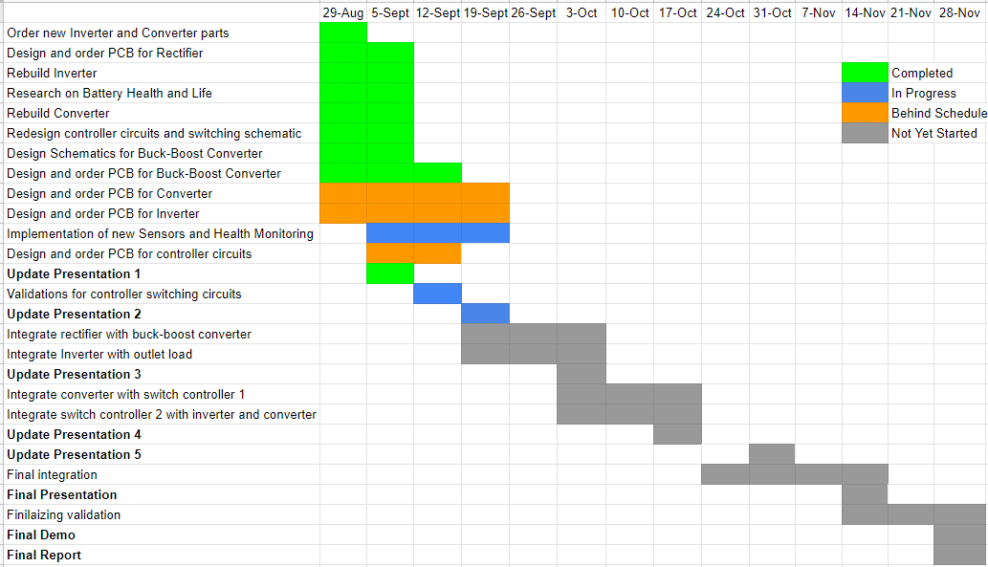
Execution & Plan

Slide 15
Thank you for listening
Any Questions?
Notes:
https://www.ryse.energy/3kw-wind-turbines/#iLightbox[gallery_image_1]/11

